Slide 1
Welcome To Presentation on our project Arduino Based Smart Home System
PRESENTED BY-
Group- 07
SECTION: H

Slide 2
Group Members
NAME | ID
ANTOR MD SHAHRIAR | 18-37294-1
ALI RAFSAN KABIR | 19-40625-1
TAMALIKA BHOWMICK | 19-41120-2
MOINUL ISLAM | 20-42390-1
SOURAV DEBANGSHU PAL | 18-37413-1
MD. TANVIR ALAM NILOY | 19-39422-1

Slide 3
Table Of Contents
Introduction.
Literature Review.
Methodology and Modeling.
Cost Analysis.
Results and Discussion.
Conclusion and future endeavors.
References.

Slide 4
INTRODUCTION
Background of Study and Motivation
It will manage all of your home devices from a single location.
It has the ability to adapt to new devices and appliances as they become available.
Project Objectives
It will Control of home functions from a distance
A short Description about our project_
Project_ Home Appliance System

Slide 5
Literature Review
Improve the overall quality of life and convenience in the home environment.
Increased security and energy efficiency.
To make daily life easier for its inhabitants by increasing their level of comfort.

Slide 6
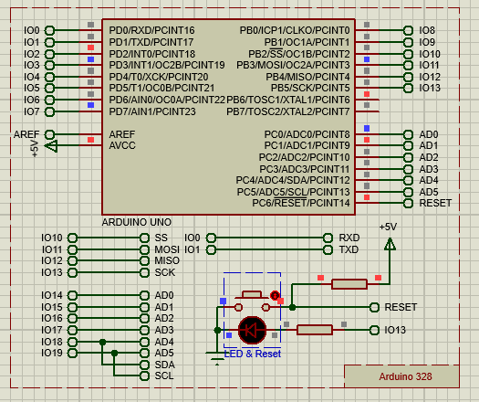
Methodology and Modeling
Arduino 328
An open-source electronics platform based on easy-to-use hardware and software
Arduino boards are able to read inputs - light on a sensor, a finger on a button and turn it into an output - activating a motor, turning on an LED,

Slide 7
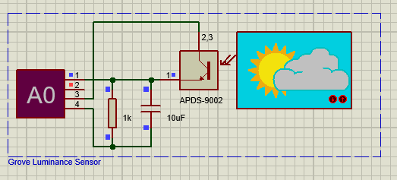
Methodology and Modeling
Grove Luminance Sensor
Detects the intensity of the ambient light on a surface area
used in application which requires automatic light adjustment in residential or commercial lighting.

Slide 8
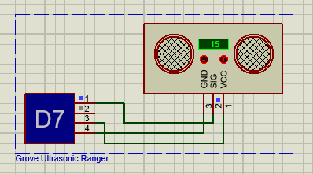
Methodology and Modeling
Grove Ultrasonic Ranger
an ultrasonic transducer that uses ultrasonic waves to measure the distance.
Can measure distances15cm

Slide 9
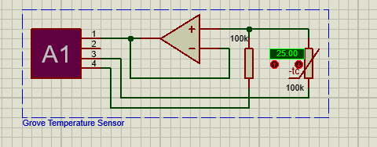
Methodology and Modeling
uses a Thermistor to detect the ambient temperature.
The resistance of a thermistor will increase when the ambient temperature decreases

Slide 10
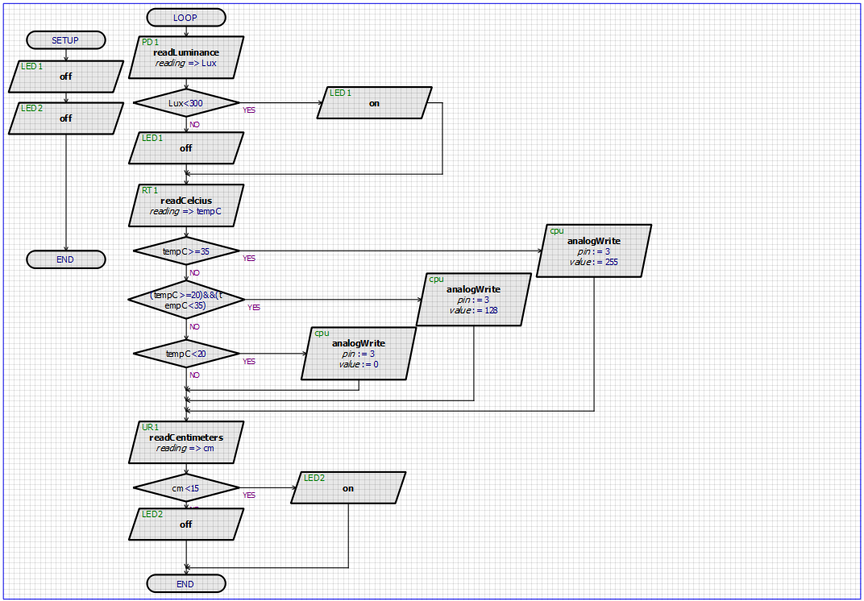
Flowchart of our Project

Slide 11
Cost analysis
Component | Quantity | Cost
Arduino Uno R3 with cable | 1 | 1350tk
Chanel Relay | 2 | 260tk
Sonar Sensor | 1 | 120tk
Jumper Wire | 2 | 220tk
Resistor | 3 | 15tk
LDR | 1 | 125tk
DHT 11 | 1 | 220tk
Bread Board | 1 | 150tk
LED | 2 | 10tk
Motor | 2 | 300tk
Battery | 1 | 60tk
Glue Stick | 1 | 50tk
 |  | Total=2880tk

Slide 12
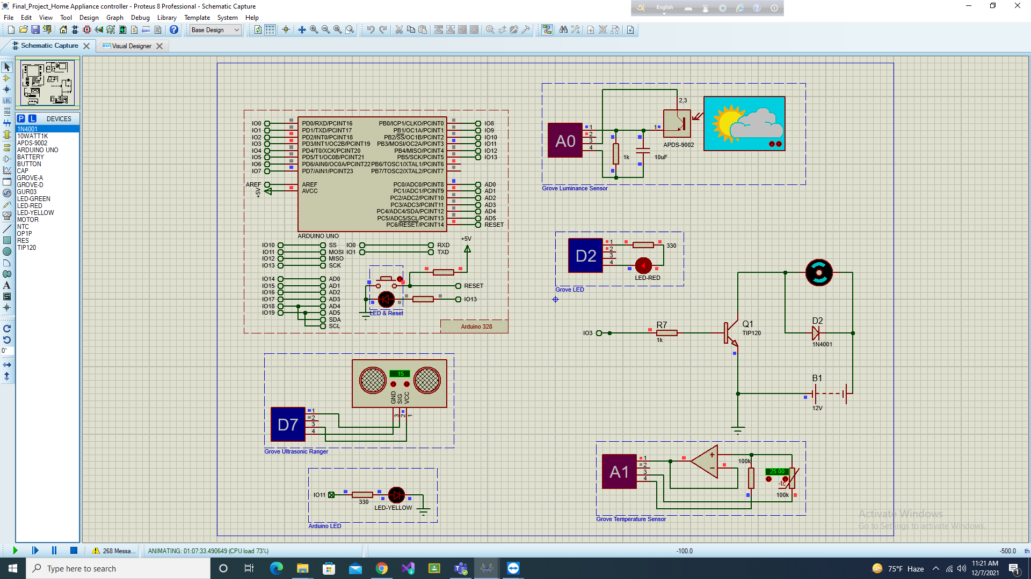
Results and Discussion
Schematic capture

Slide 13
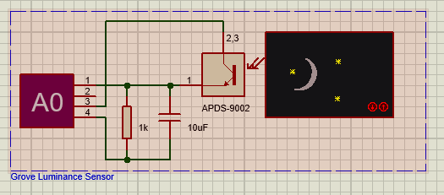
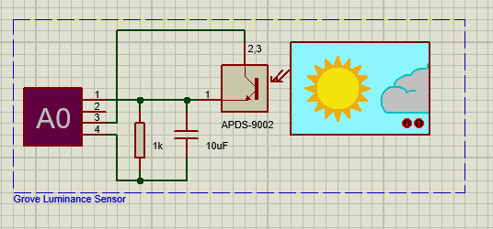
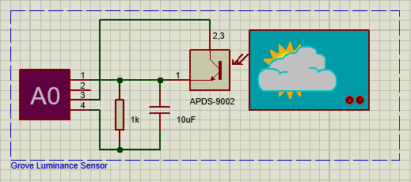
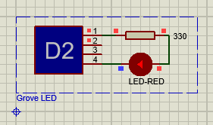
Results and Discussion Led Will be turned on when the weather is cloudy or night

Slide 14
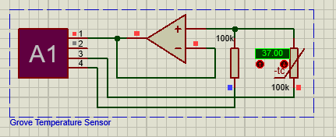
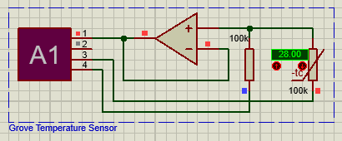
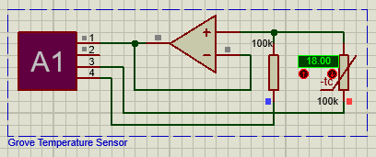
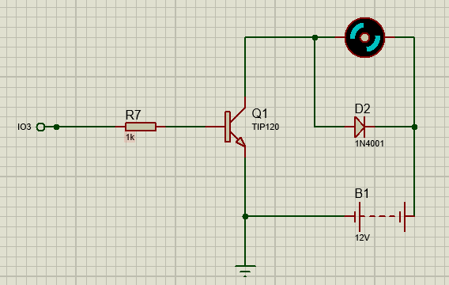
Results and Discussion
When the temperature will above 22 degree Celsius, Motor 1 will be run in full speed
When the temperature will above 25 degree Celsius, Motor 1 and 2 will be run in full speed
When then temperature will below 22 degree Celsius, Motor will be turned off

Slide 15
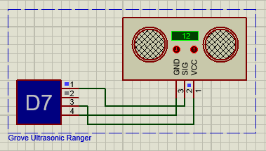
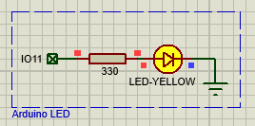

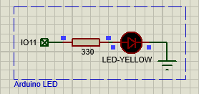
Results and Discussion
When it will be in range 15 cm the led will be turned on
When it will be above 15cm the led will be turned off

Slide 16
Limitation of our project
The ultrasonic ranger sensor does not know how to distinguish between right or wrong person which could trigger redundant electricity supply.
Everyone has different preferences for fan speed at different temperature which can lead to a problem because the fan speed settings cannot be changed by the consumer.
Sometimes people does not prefer to turn on light at certain times which is another limitation of our project as light on/off is based on luminance sensor settings.

Slide 17

Conclusion
WE are six members of a group. WE worked together. We are very co-operative each other. When we faces problem we came out a solution easily because we worked together.

Slide 18
References
[1] “World Population Ageing” Department of Economic and Social Affairs Population Division, United Nations, New York, 2013J. Clerk Maxwell, A Treatise on Electricity and Magnetism, 3rd ed., vol. 2. Oxford: Clarendon, 1892, pp.68–73.
[2] Ma Naing, Ni Ni San Hlaing K. Elissa “Arduino Based Smart Home Automation System” pp. 276
[3] Subhankar Chattoraj “Smart Home Automation based on different sensors and Arduino as the master controller’’ Volume 5, Issue 10, October 2015, pp – 736
[4] International Journal of Scientific Research in Information Systems and Engineering VOLUME 2, ISSUE 2, AUGUST – 2016. ISSN 2380-8128
[5] Daniel Chioran and Honoriu Valean, “Arduino based Smart Home Automation System” International Journal of Advanced Computer Science and Applications(IJACSA), 11(4), 2020. http://dx.doi.org/10.14569/IJACSA.2020.0110410
[6] Pedro F. Pereira, Nuno M. M. Ramos, M. Lurdes Simões. (2020) Data-driven occupant actions prediction to achieve an intelligent building. Building Research & Information 48:5, pages 485-500.

Slide 19


